Slide 1
Code optimization

Slide 2
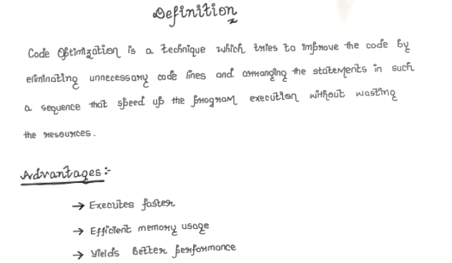

Slide 3
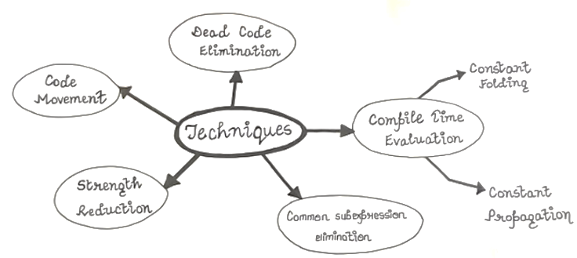

Slide 4
Issues
Two issues in code optimization is
1. Semantic equivalence of the source program must not be changed
2. It must be achieved without changing the algorithm of the program

Slide 5
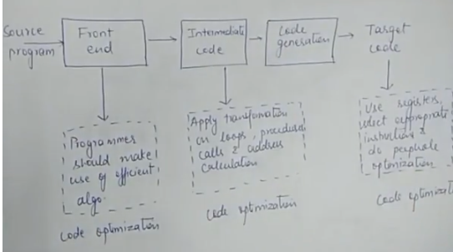
Where to apply

Slide 6
Types – Compile Time Evaluation
Optimize the code at the compile time – two techniques -constant folding and constant propagation
constant folding – technique of evaluating an expression whose operands are known to be constants at compile time itself.
22/7 is a constant expression
So first solve the constant expression before and keep the constant value – so called folding the constant and place the value at compile time since evaluated at compile time and keep the value of reuse

Slide 7
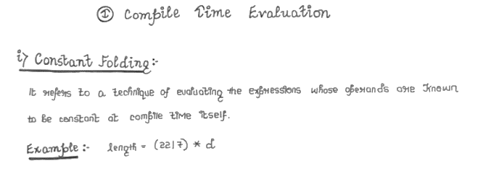

Slide 8
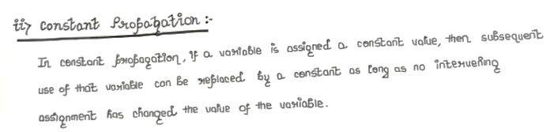
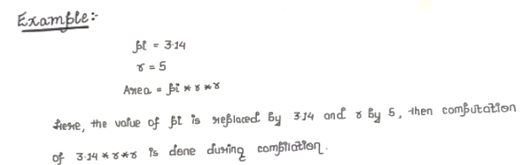

Slide 9
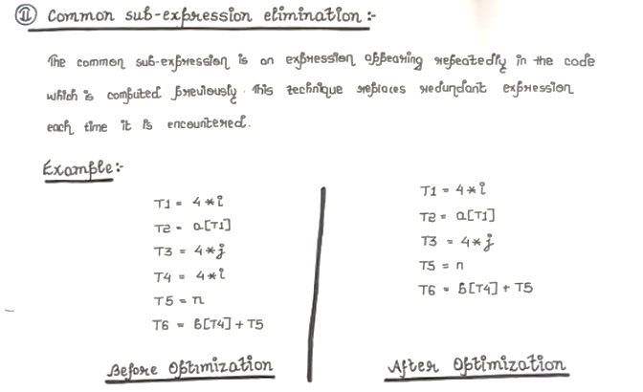
Common sub expression Elimination
Above is the 3 address code
So 4*I is not executed second time for T4 and value of T1 is taken for T4
So no redundant expression in the optimized code

Slide 10
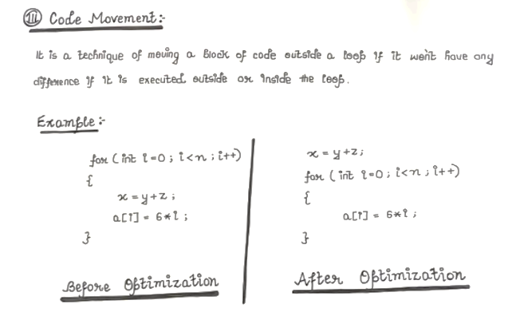
Code Movement

Slide 11
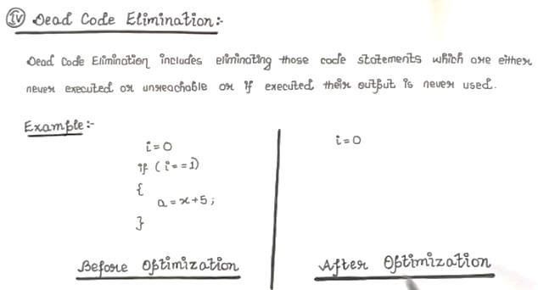
Dead code Elimination

Slide 12
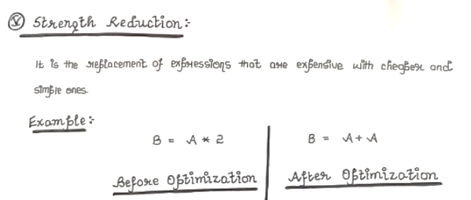
Strength Reduction

Slide 13
Loop Optimization Techniques
Code motion technique or code movement
Induction variable
Loop invariant method
Loop unrolling
Loop fusion or loop jamming

Slide 14
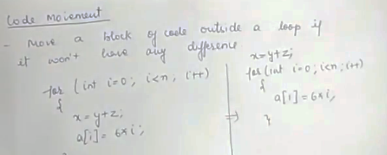
Code motion technique or code movement

Slide 15
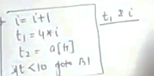
Induction variable
Variable x is an induction variable of loop L such that
Value of the induction variable of loop get changed every time – either incremented or decremented
Here t1 depends on I and so t1 and I are locked and so called induction variables of the block

Slide 16
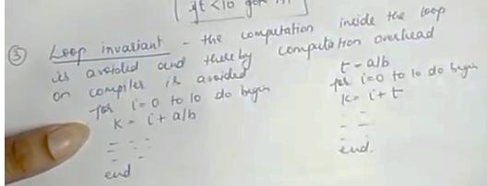
Loop invariant method
Computation inside the loop is avoided and thereby computation overhead on compiler is avoided
L
L
L
L
l

Slide 17
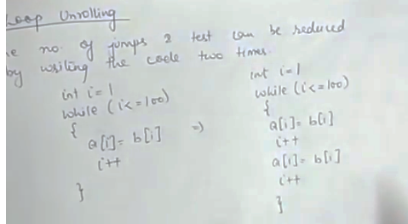
Loop unrolling
Number of jumps and tests can be reduced by writing the code two times
the no of steps to some extent by repeating the operation in the body is reduced

Slide 18
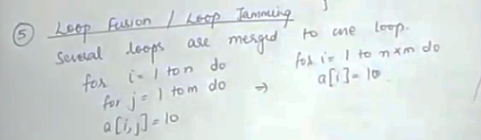
Loop fusion or loop jamming
Several loops are merged to one loop

